Slide 1

TEAM 1 - Project Phase 1
Group Members
Raviraj Ahire - Introduction , Data Elements
Amita Akole - Table And Column For the Adult Database
Mohammed Zeeshan Ali - Data Elements , Query Slide
Pooja Deepak Bhamare - 9th Slide and 10th Slide
Shivangi Jagdishkumar Bhavsar - ER Diagram and Summary
IS 664 - DATABASE PROGRAMMING

Slide 2
INTRODUCTION
Zeeshan
To design an ER diagram and tables in MySQL workbench for the file in a schema named “adults”.
From the model data fields given , identified the data elements and subdivide each element into its smallest useful component and discover relievency between employee
and its occupation .
To identify the tables and assign columns and identify the primary
and foreign keys.
To review whether the data structure is normalized and identify the
indexes.
IS 664 - DATABASE PROGRAMMING

Slide 3
DATA ELEMENTS FOR ADULT DATA SET
Zeeshan
Data elements define the characteristics of a table field and the rowtype of the table type.
Schema Adult consists of following data element for the fictitious organization , Datagrowth inc. which consists information of company employees and its occupation.
IS 664 - DATABASE PROGRAMMING

Slide 4
DATA ELEMENTS
Amita
Employee ID
Sex
Race
Relationship
Native country
Marital Status
Age
Education Id
Occupation ID
Occupation
Workclass
Education
Education_num
Capital gain
Capital loss
Income
Hours per week
Demographic weight
IS 664 - DATABASE PROGRAMMING

Slide 5
Amita
Tables and Columns for the Adult Database
IS 664 - DATABASE PROGRAMMING

Slide 6
Amita
Employee_details | Education_Info | Occupation_details
Emp_Id | Edu_ID | Ocu_ID
Age | Emp_ID | Edu_ID
Marital_Status | Education | Occupation
Sex | Education_num | Workclass
Race |  | Emp_ID
Relationship |  | Income
Native_country |  | Hours_per_week
Demographic Weight |  | Capital gain
 |  | Capital loss
IS 664 - DATABASE PROGRAMMING

Slide 7
IDENTIFY THE PRIMARY AND FOREIGN KEY
Primary key :- It uniquely identifies each record in a table in a relational database.
Foreign key:- A foreign key is a field in one table that refers to the primary key in another table.
Emp_ID , Edu_ID , Ocu_Id are the primary key in respective tables Employee _details ,Education_Info ,Occupation_details .
Where As Emp_ID is FK for Education_Info Occupation_details and
Edu_ID is Fk for Occupation_details.
IS 664 - DATABASE PROGRAMMING

Slide 8
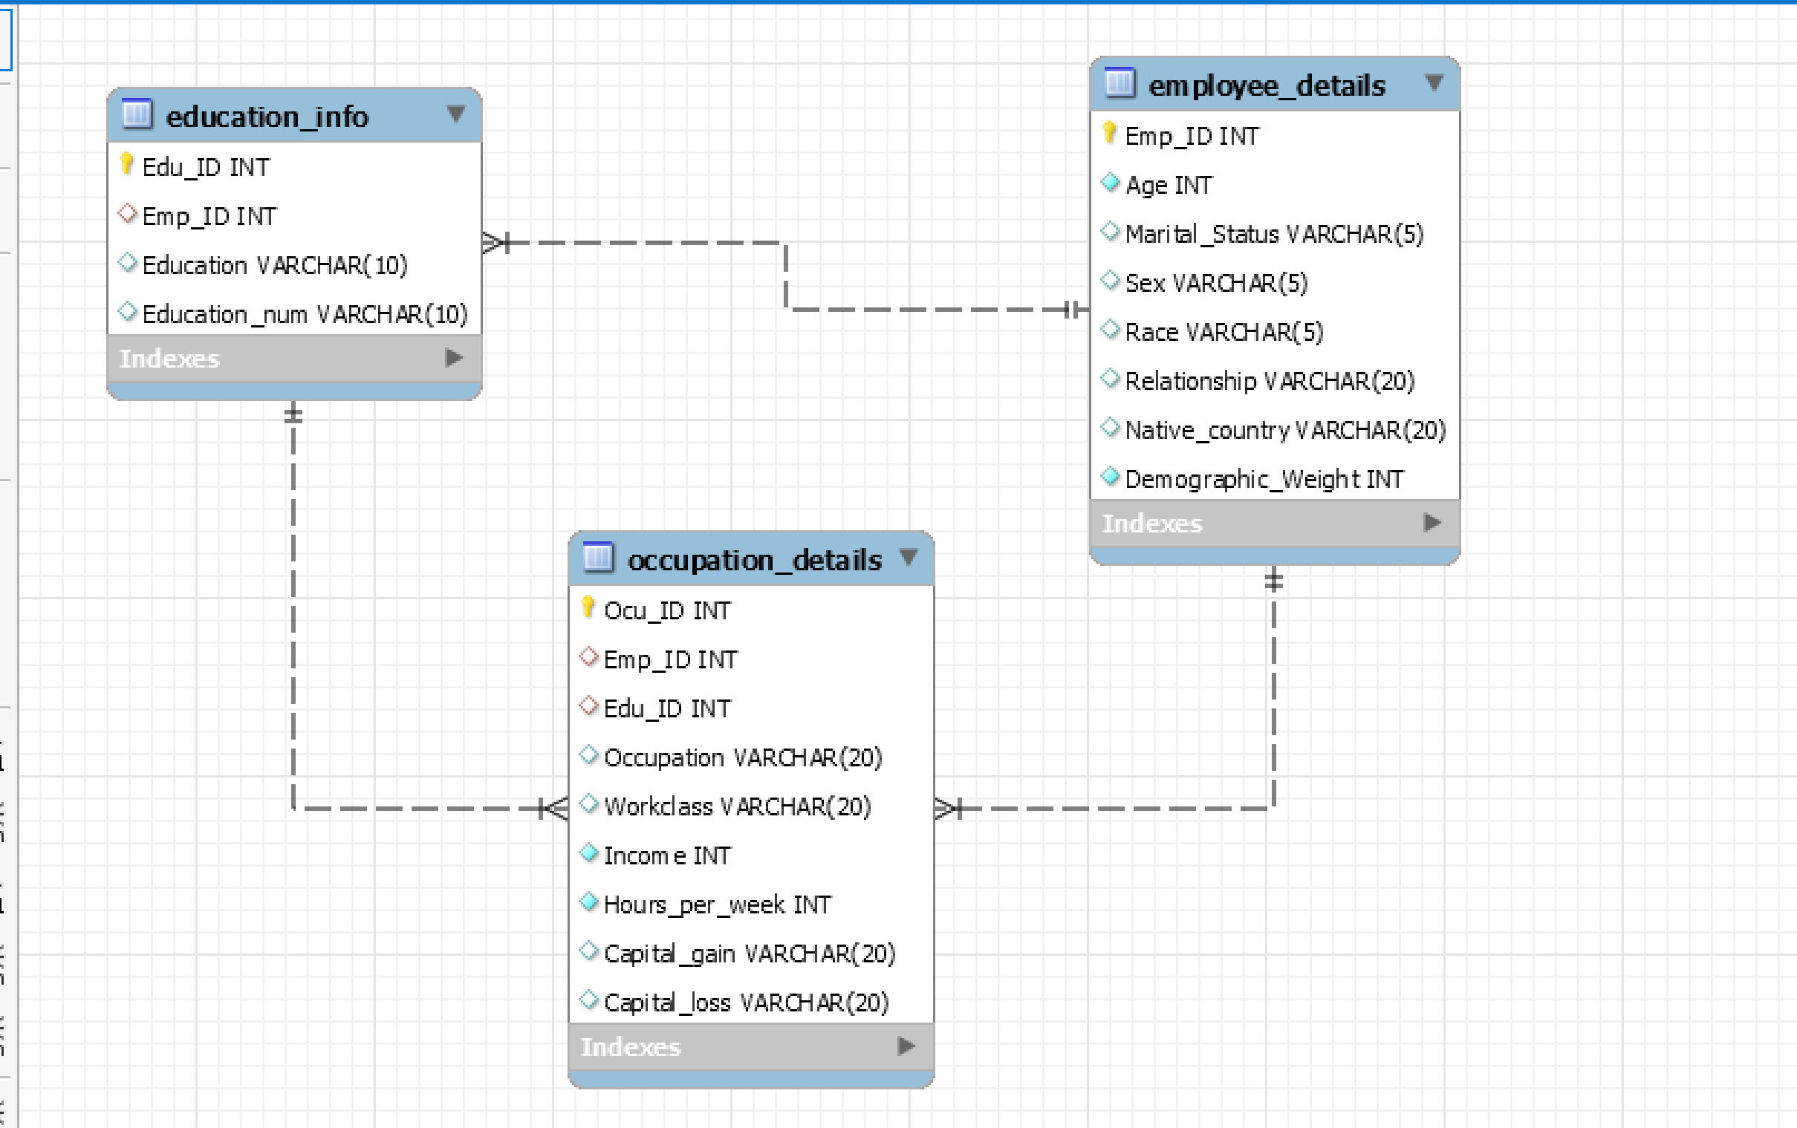
Shivangi
ER DIAGRAM
IS 664 - DATABASE PROGRAMMING

Slide 9
After working on the data , it is understood that the data is normalized using 1NF and 2NF normalization methods.
Pooja
Reasons for normalization of data :
Reduce duplicate data
Performance and Metrics
IS 664 - DATABASE PROGRAMMING

Slide 10
INDEXES
Pooja
Indexes are used to quickly locate data without having to search every row in a database table every time a database table is accessed.
INDEXING is a way of sorting a number of records on multiple fields.
IS 664 - DATABASE PROGRAMMING

Slide 11
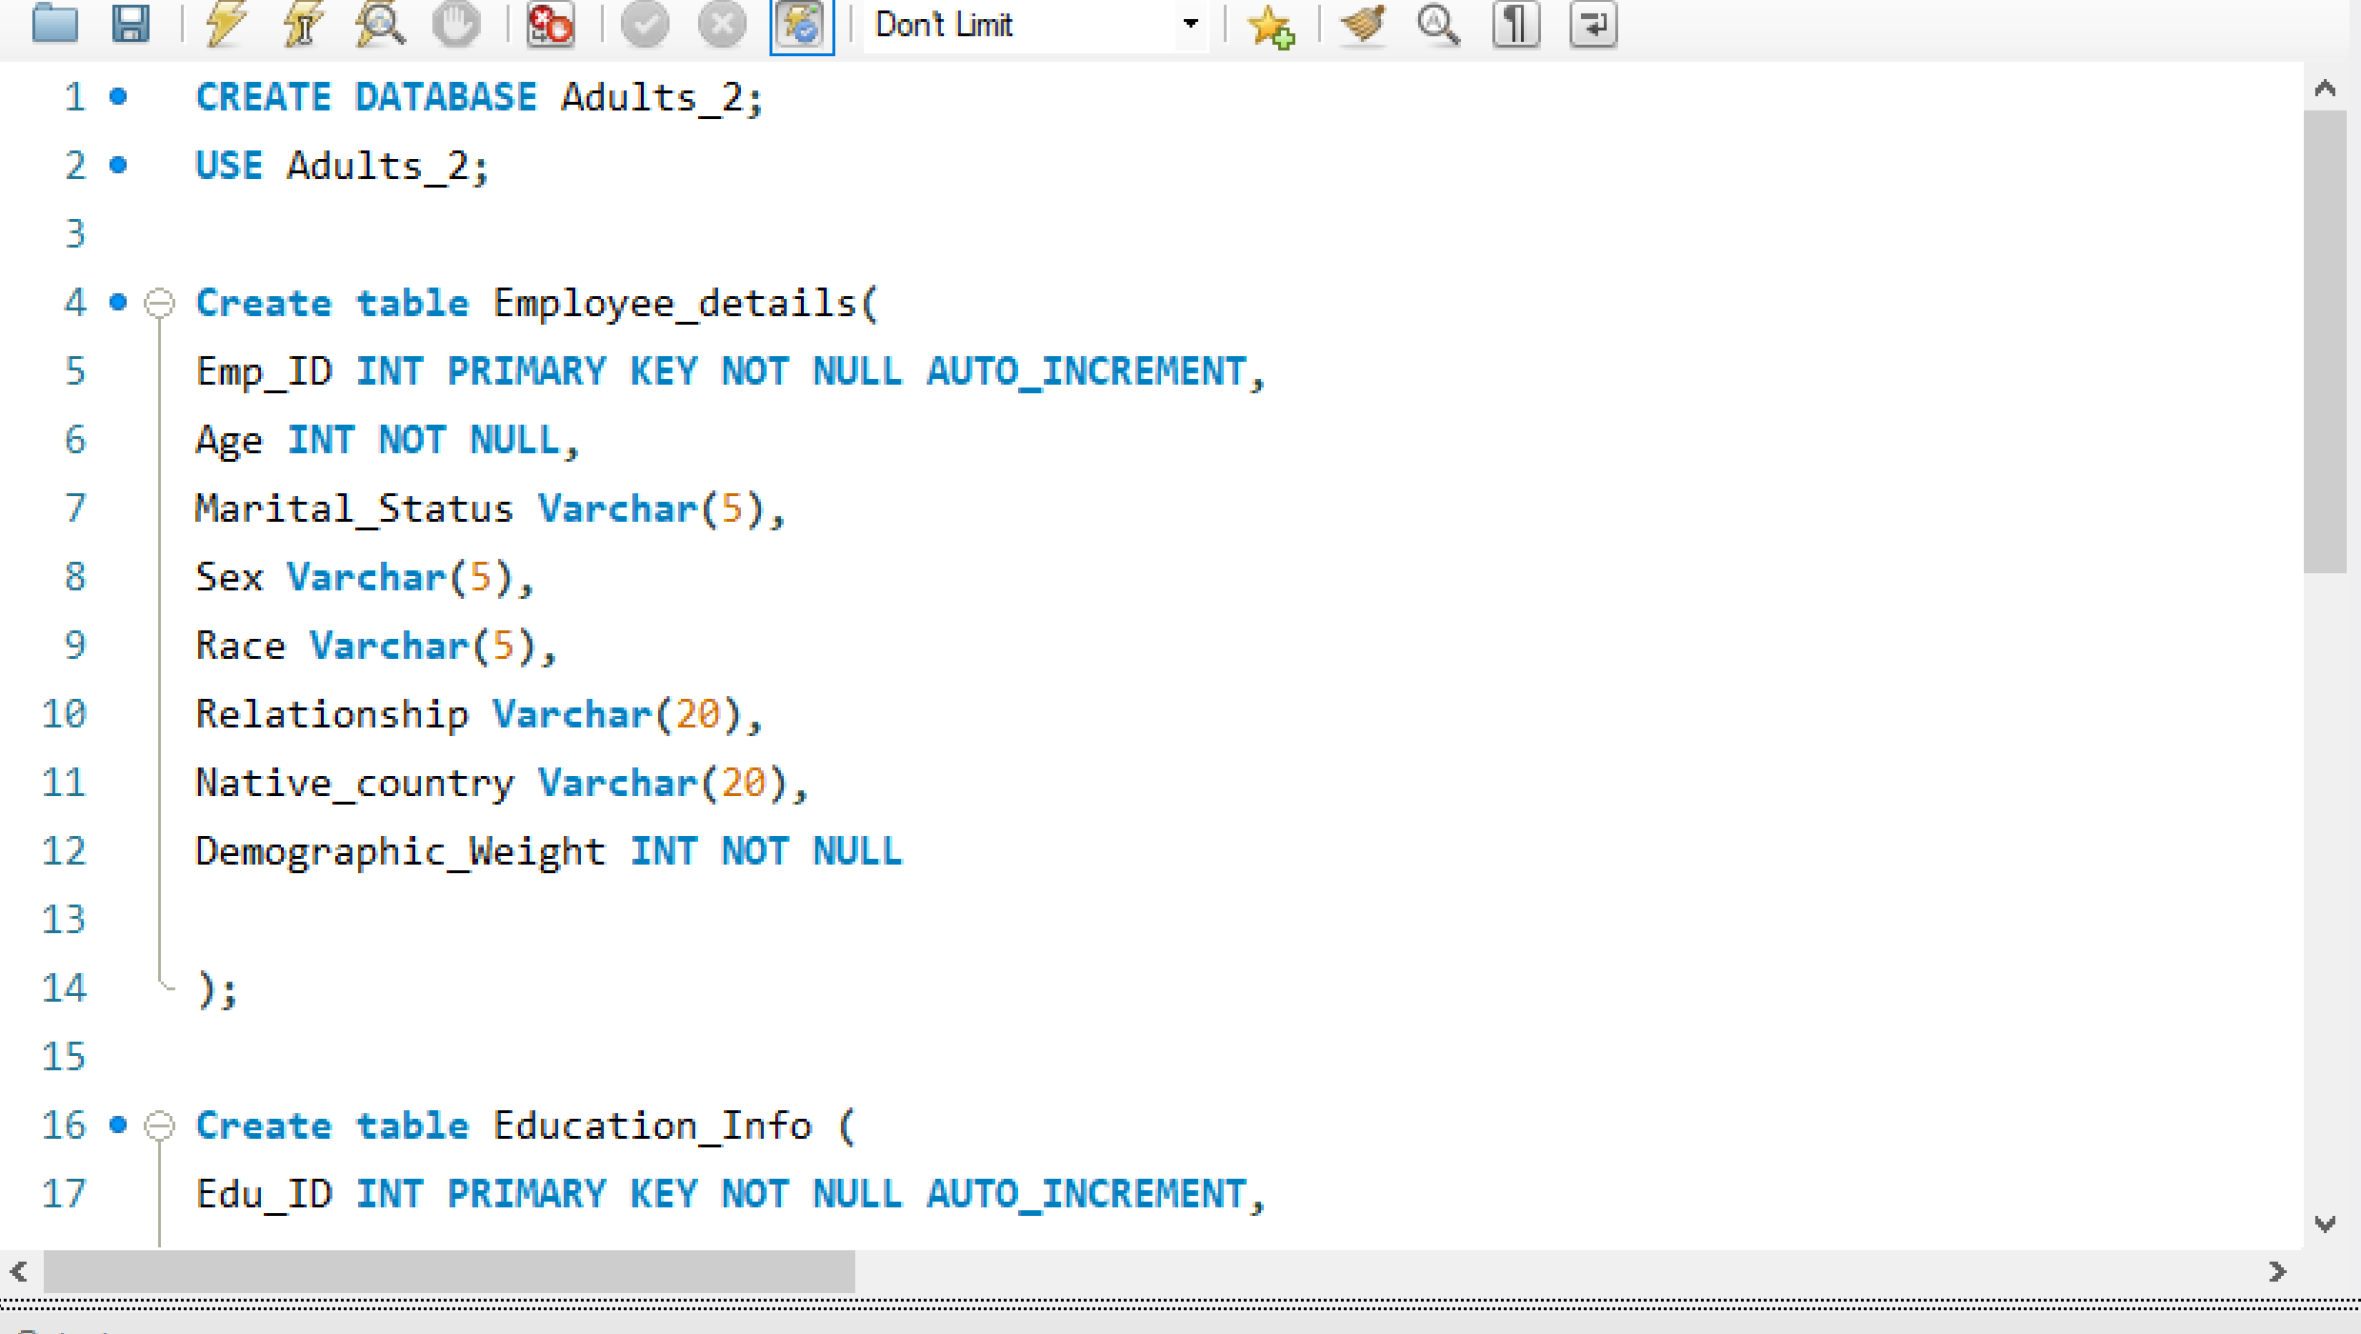
Raviraj

Slide 12
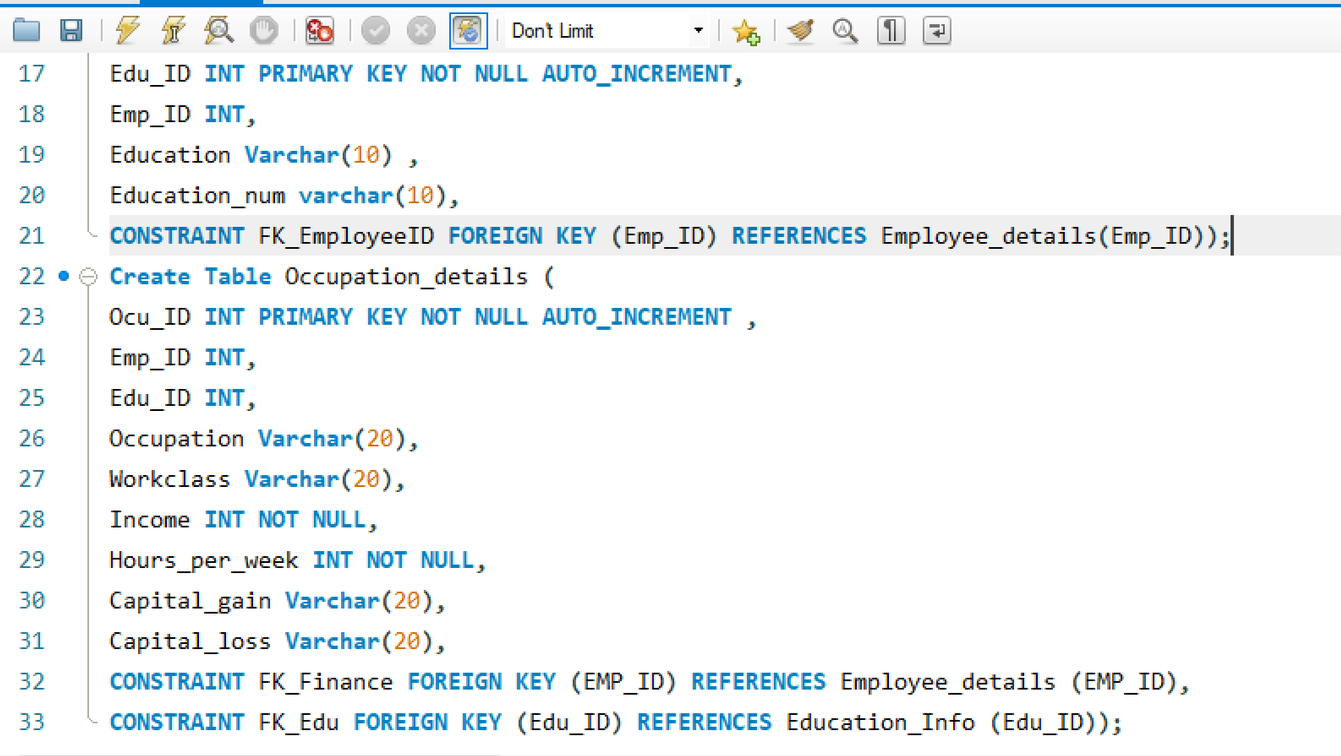
Raviraj

Slide 13
SUMMARY
Shivangi
We have successfully identified the data elements and subdivided them into smallest useful components.
Identified the tables and assigned columns by allocating primary and foreign keys.
Ensures Referential Integrity of the database
Successfully performed normalization on our database structure.
Successfully identified the indexes.
IS 664 - DATABASE PROGRAMMING

Slide 14
THANK YOU!!!!!
IS 664 - DATABASE PROGRAMMING

